Slide 1
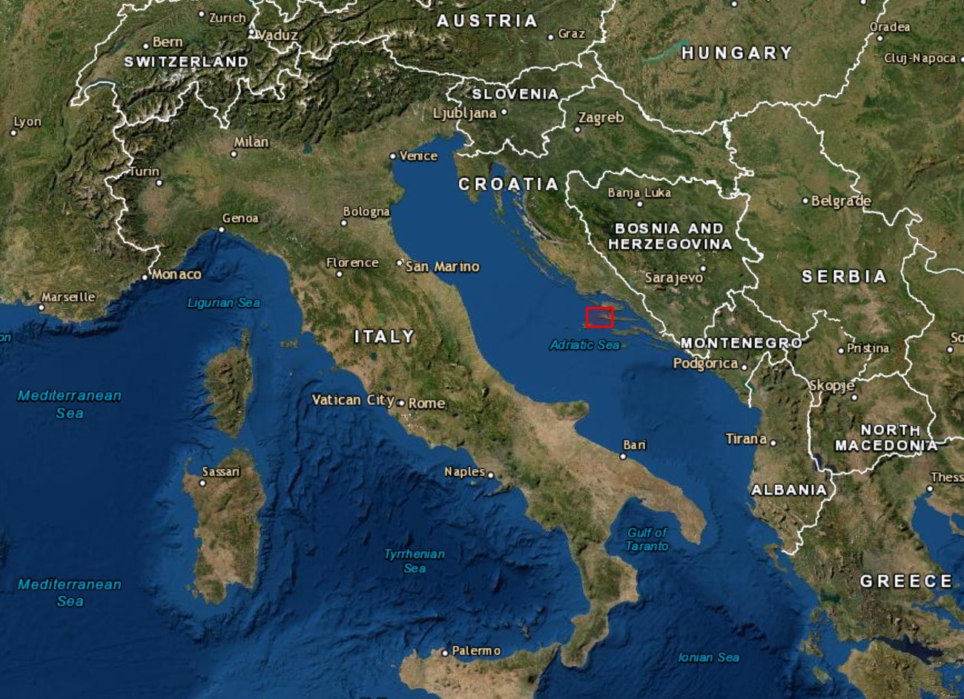
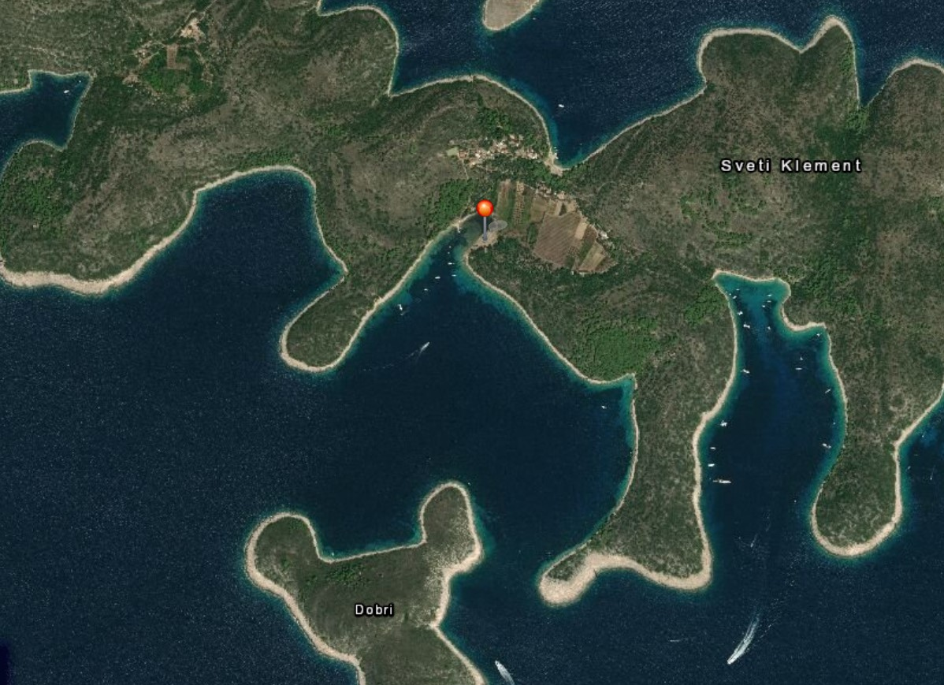
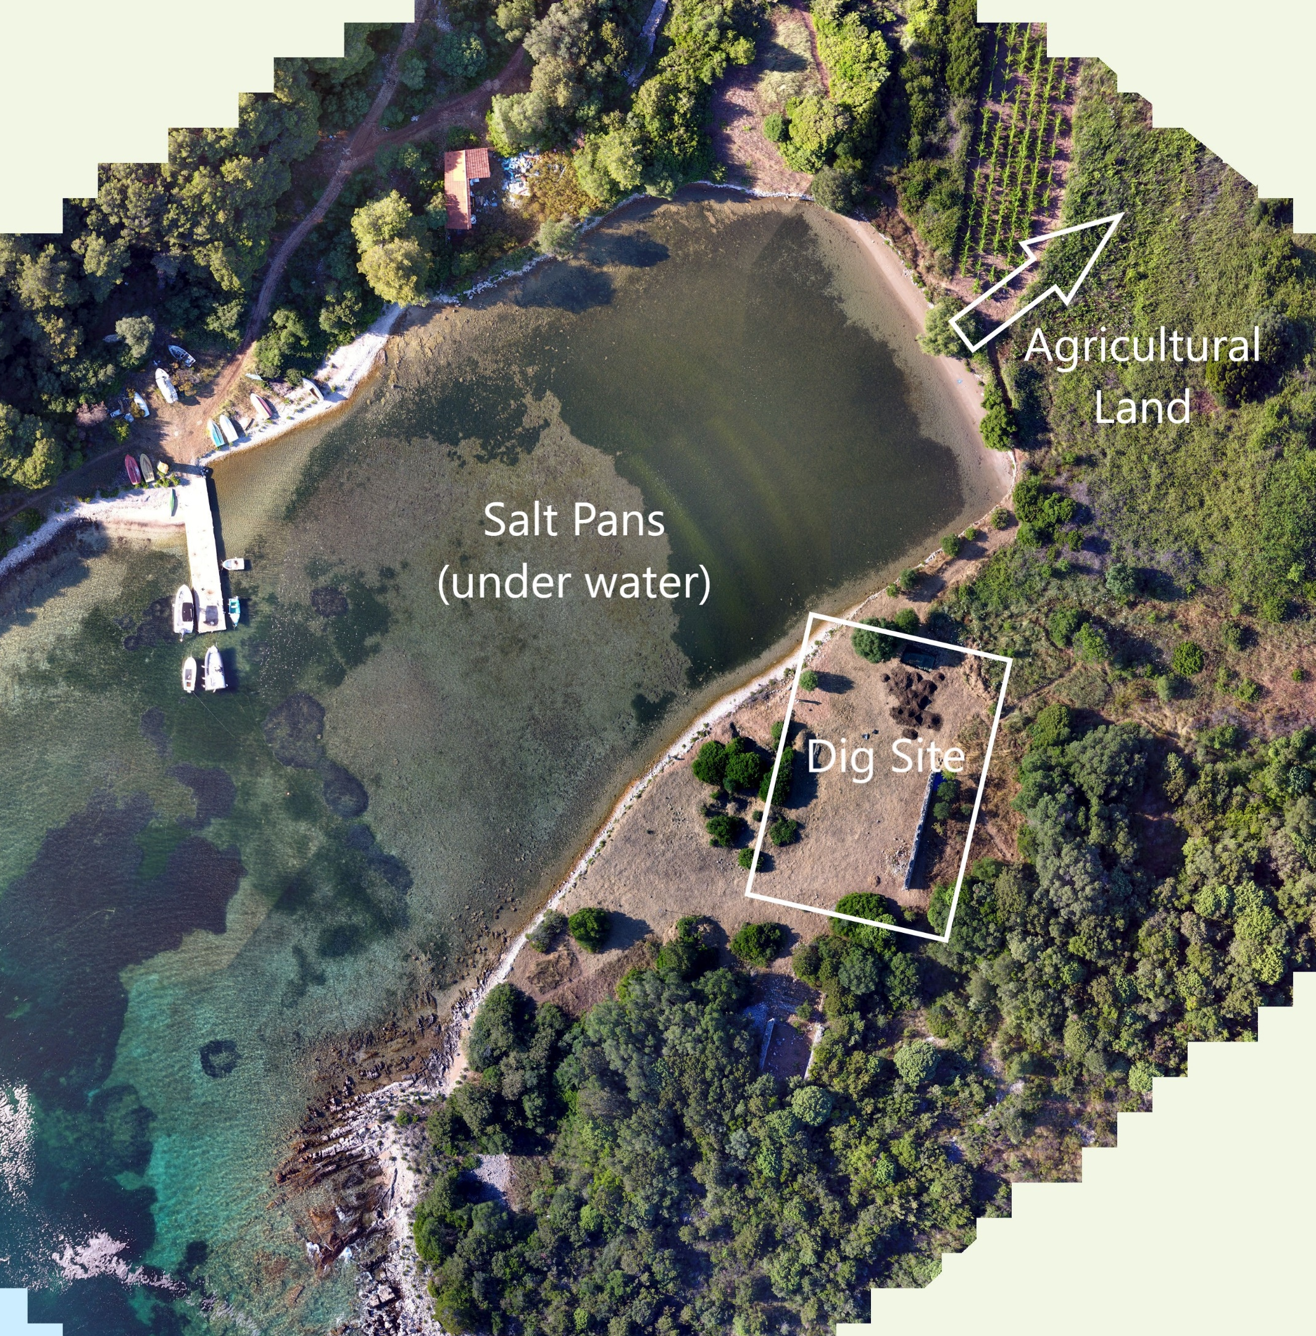
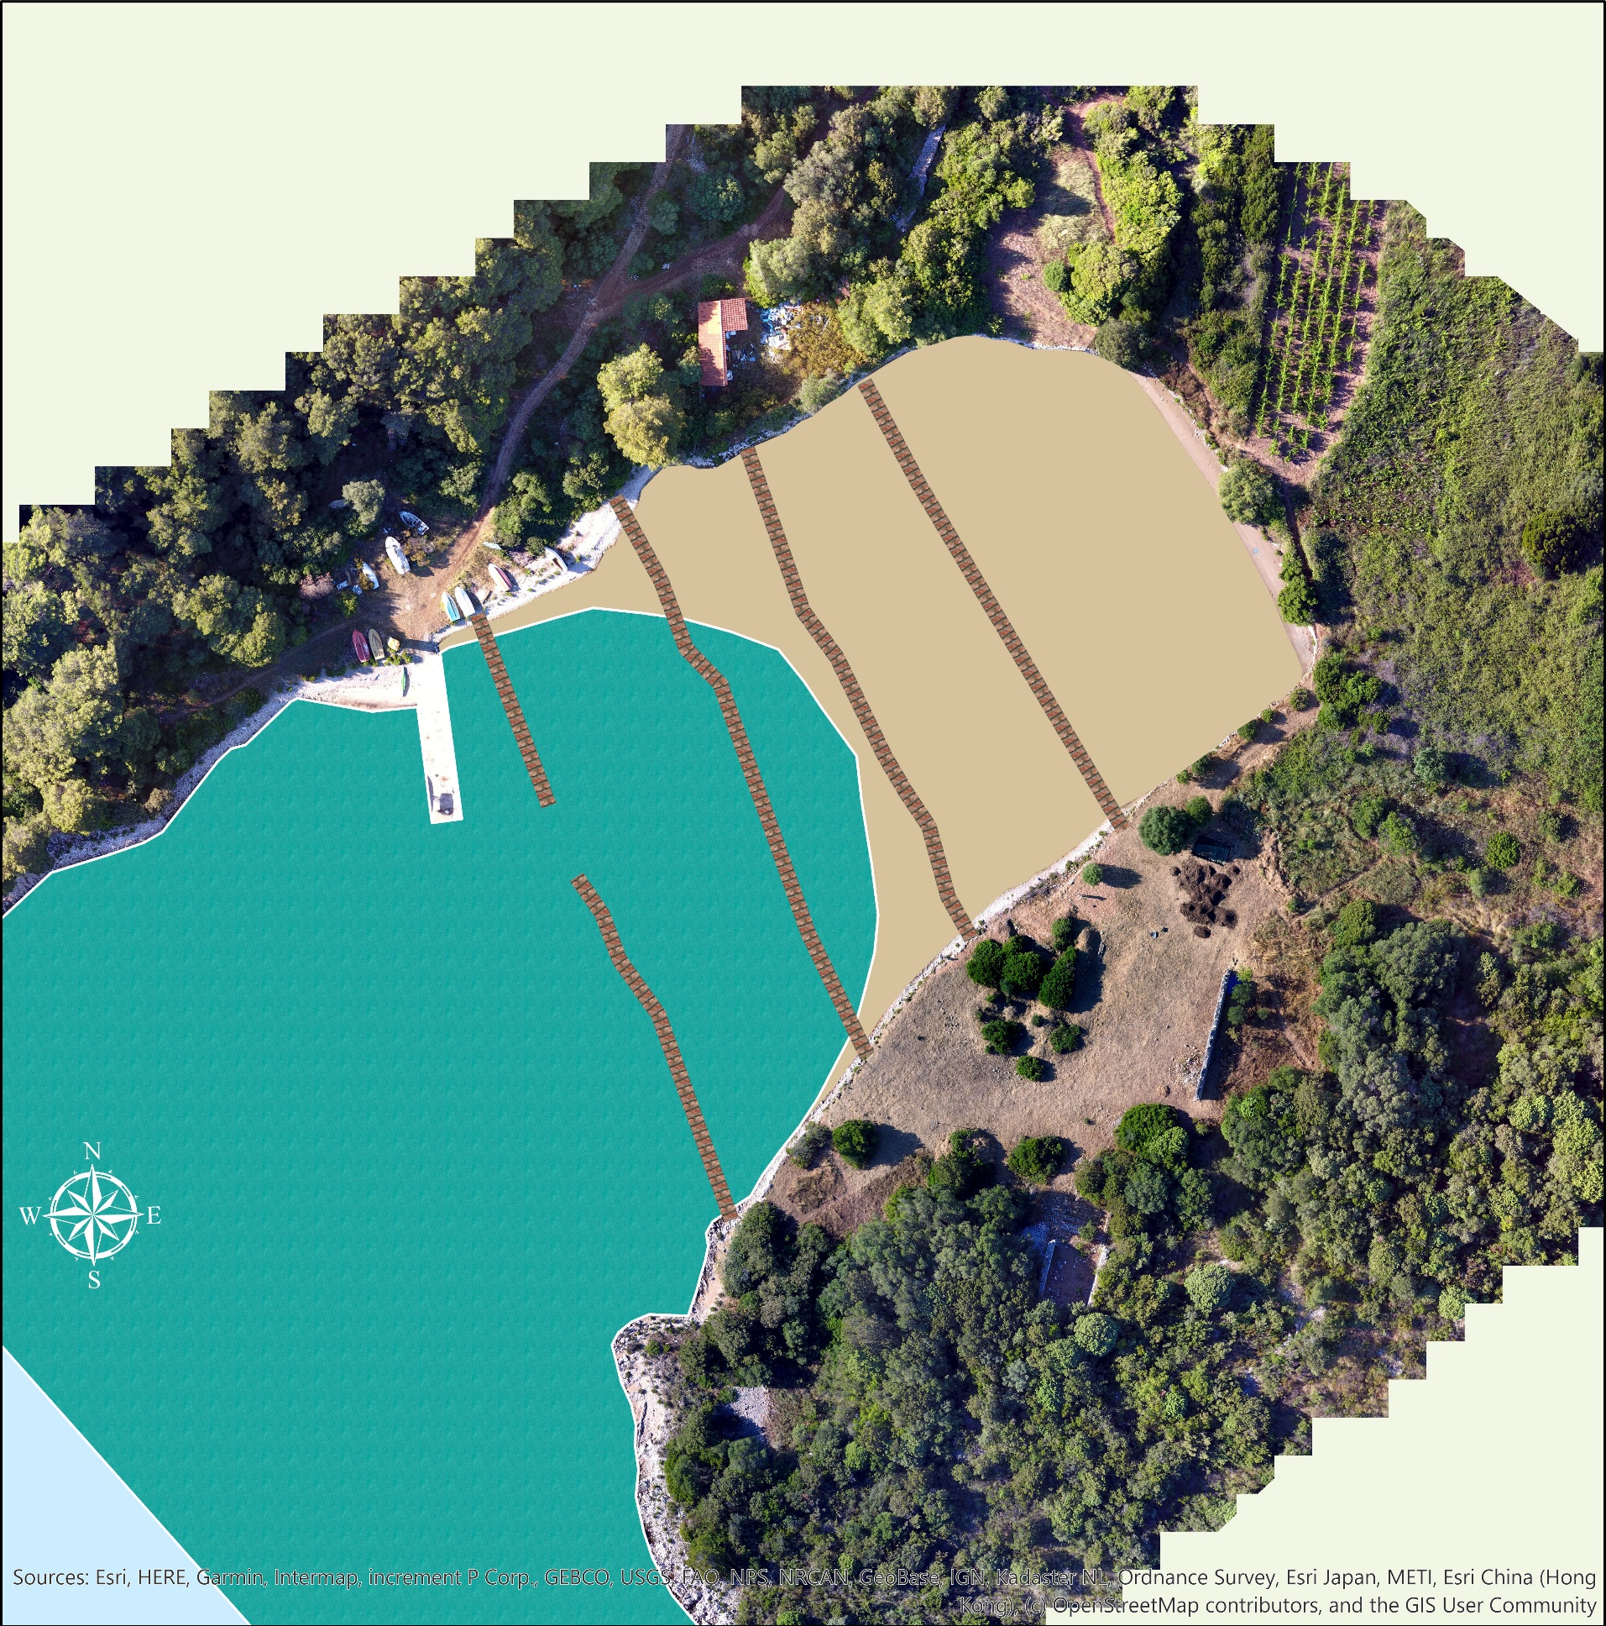
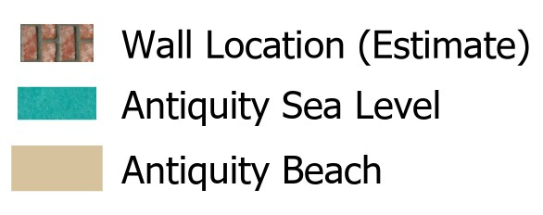
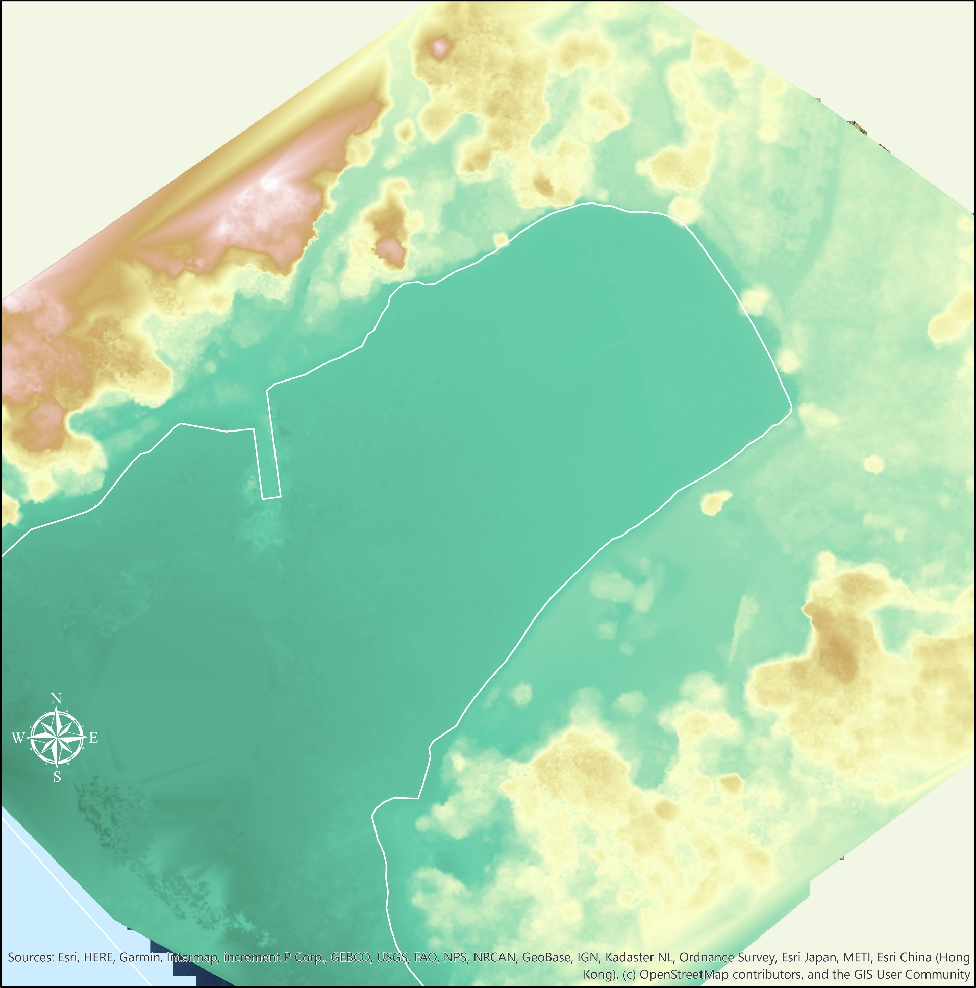
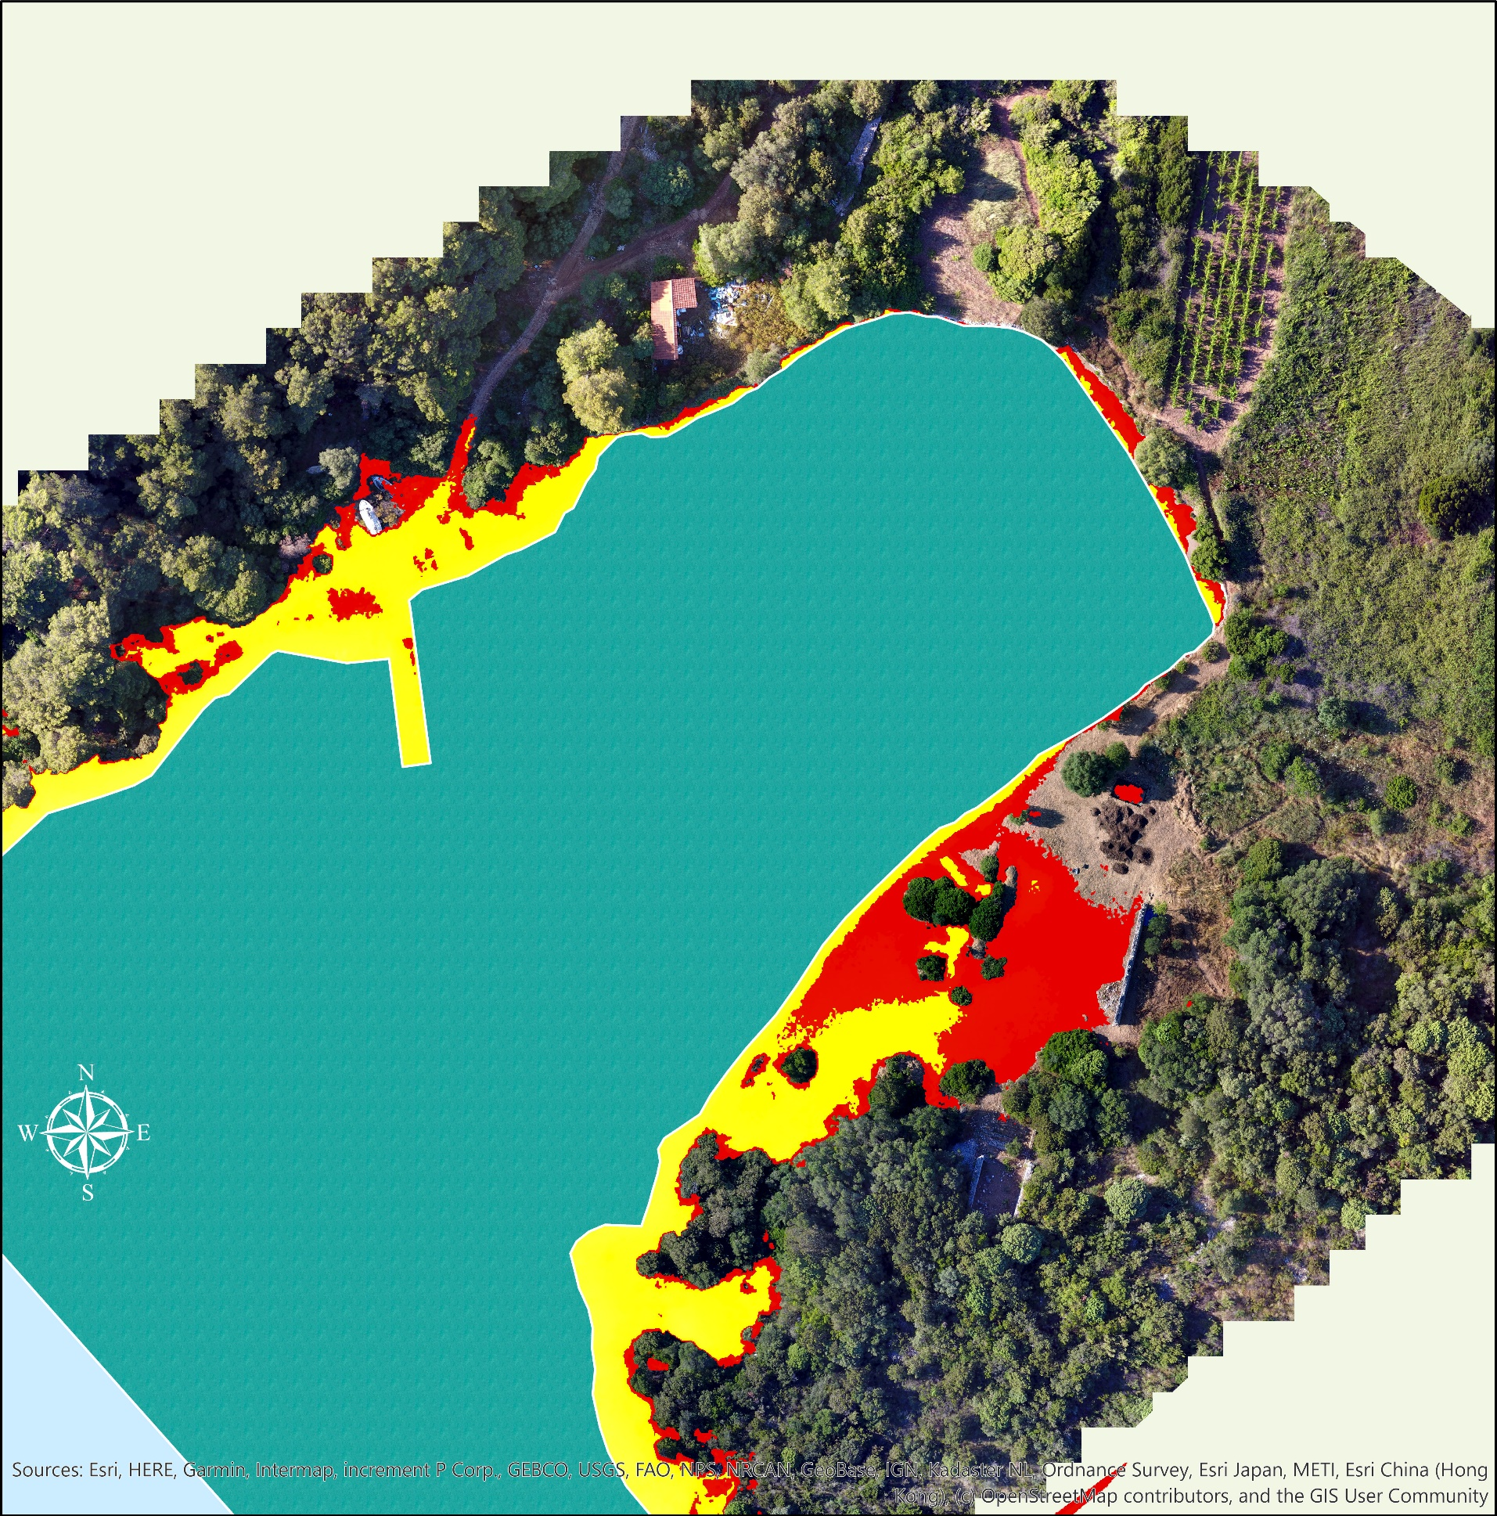

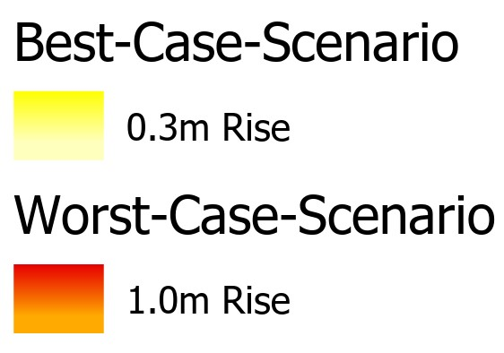
Sea Level Rise in Soline Bay,
St. Klement Island, Croatia
Jacob Slaughter, Dr. David Kelley and Dr. Ivančica Schrunk
University of St. Thomas Undergraduate Research Opportunities Program
Drone images can be processed with GIS tools to generate predictive maps of sea level changes in the past and the future.
Introduction
The Mediterranean region was under the control of the Roman Empire during classical antiquity from about one hundred years B.C. through the fifth century A.D.
The archaeological site of Soline Bay on St. Klement Isalnd has been under excavation since 2007 under Dr. Ivančica Schrunk of the University of St. Thomas
Sea level (SL) rise has caused substantial changes to the profile of Soline Bay which are discoverable via archaeological findings, climate change research, drones, and GIS technology
1st Century B.C. – 5th Century A.D. (Figure 1)
Results
An orthomosaic (Site Layout) and a DSM (Digital Surface Model) were generated in ArcGIS Pro using a collection of drone images taken at the site in 2018
The orthomosaic is a high-quality image of the entire site and the DSM models elevation
Figure 1 shows the shoreline at antiquity, and the estimated location of the salt pan walls
Figure 2 shows the best-case-scenario and worst-case-scenario/storm surge for sea level rise by the year 2100
The dig site is the most vulnerable to the worst potential flooding
Site Layout
Research Question
Research on SL suggests close to 2 meters of rise has occurred at Soline
Underwater salt pans at the site provide insights into SL rise, as they would have been built according to SL at the time
Dr. Schrunk and her team found that the salt pans were ~2 meters below SL
With an understanding of these ancient structures’ function and location, where was the shoreline at Soline Bay during antiquity when the Romans built on the land?
Storm surges have already proved to temporarily increase SL by 1 meter, and research has provided predictions for SL rise to come by the year 2100 near Soline Bay
Using current climate models, what could coastal inundation look like for Soline Bay in by the year 2100?
Conclusion
It’s possible to use drone images to ultimately generate maps displaying sea level change
The use of drone technology paired with powerful GIS software proved itself valuable for the ongoing research at Soline Bay
Whether Soline Bay sees the best-case-scenario or the worst-case-scenario, there will eventually come a time when excavating the site is no longer a possibility
Coastal inundation at archaeological sites is happening now and is going to become more challenging and more problematic into the future as climate change continues
As more time is spent researching the site of Soline Bay, more history can be revealed through GIS processes
Digital Surface Model
Inundation by 2100 (Figure 2)
Bibliography:
Pavlova, P., Markova, K., Tanev, S., Davis, J.S. 1998. Observations on a solar saltworks near Burgas, Bulgaria. International Journal of Salt Lake Research, 7(4), 357-368.
Surić, M. (2009). Reconstructing sea-level changes on the eastern adriatic sea (Croatia)–an overview. Geoadria, 14(2), 181-199.
Radić Rossi, I. (2017). The study of sea-level changes at coastal archaeological sites. Vjesnik Za Arheologiju i Historiju Dalmatinsku, 110(2), 549-576.
Begović, V., Schrunk, I. 2009. Rising of the sea level on the eastern Adriatic - evidence of Roman villa sites, in M. Oluić (ed.), Proceedings of the First International Conference on Remote Sensing Techniques in Disaster Management and Emergency Response in the Mediterranean Region, Zagreb, 289-300.
Barić, A., et al. (2008). Potential implications of sea-level rise for Croatia. Journal of Coastal Research, 24(2 (242)), 299-305.

